Slide 1
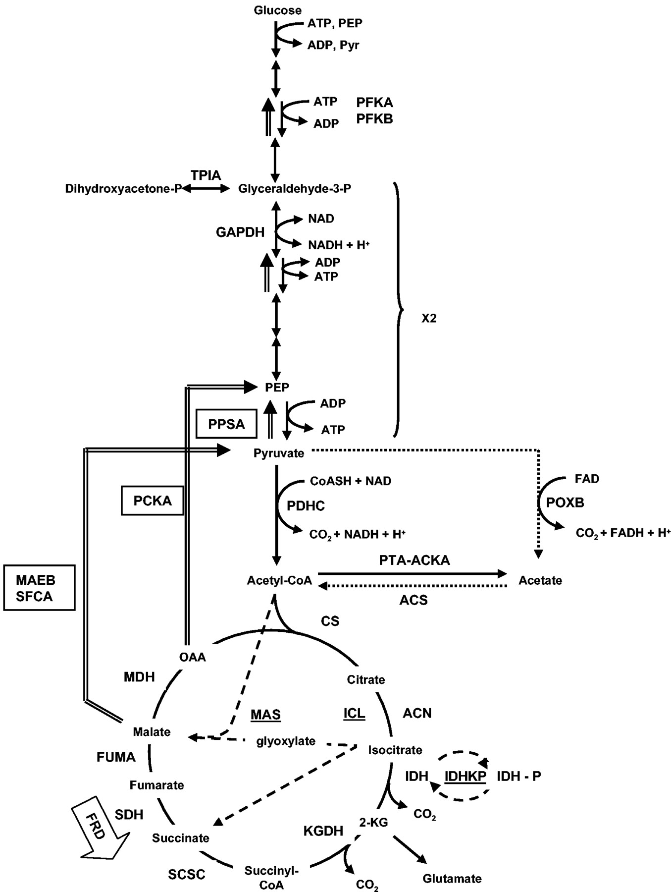
The pathways of central metabolism.
Alan J. Wolfe Microbiol. Mol. Biol. Rev. 2005; doi:10.1128/MMBR.69.1.12-50.2005
Notes:
The pathways of central metabolism. For glycolysis, only some of the intermediates and enzymes of glycolysis are noted. PEP, phosphoenolpyruvate; Pyr, pyruvate; PFK, phosphofructokinase; TPIA, triosephosphate isomerase; GAPDH, glyceraldehyde-3-phosphate dehydrogenase; PDHC, pyruvate dehydrogenase complex. For acetate metabolism: POXB, pyruvate oxidase; PTA-ACKA, phosphotransacetylase-acetate kinase pathway; ACS, AMP-forming acetyl-CoA synthetase. The dotted arrows denote the proposed PDHC bypass formed by POXB and AMP-ACS. For the TCA cycle: CS, citrate synthase; ACN, aconitase; IDH, isocitrate dehydrogenase; 2-KG, 2-ketoglutarate; KGDH, 2-ketoglutarate dehydrogenase; SCSC, succinyl-CoA synthetase complex; SDH, succinate dehydrogenase; FUMA, fumarase; MDH, malate dehydrogenase; OAA, oxaloacetate. FRD, fumarate reductase, expressed under anaerobic conditions, bypasses SDH. For the glyoxylate bypass: ICL, isocitrate lyase; MAS, malate synthase; IDHK/P, isocitrate dehydrogenase kinase/phosphatase. Underlines and dashed arrows denote enzymes and steps unique to the glyoxylate bypass. For gluconeogenesis: PPSA, PEP synthase; PCKA, pyruvate carboxykinase; MAEB and SFCA, malic enzymes. Boxes and double-lined arrows denote enzymes and steps unique to gluconeogenesis.

Slide 2
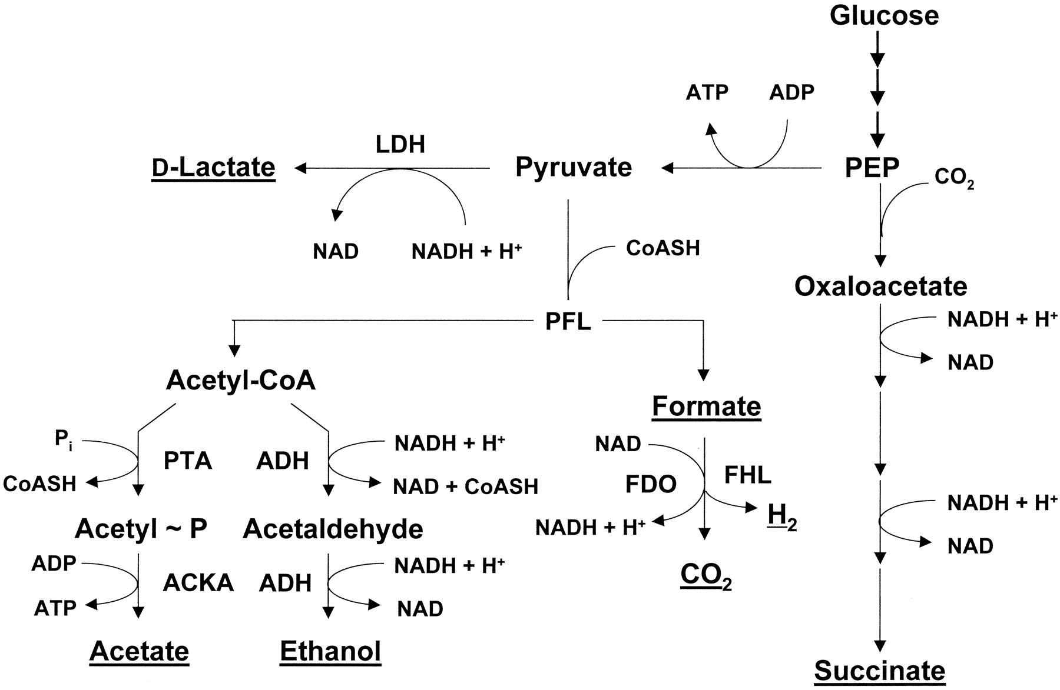
Pathways for the excretion of partially oxidized metabolites.
Alan J. Wolfe Microbiol. Mol. Biol. Rev. 2005; doi:10.1128/MMBR.69.1.12-50.2005
Notes:
Pathways for the excretion of partially oxidized metabolites. Excreted metabolites are underlined. LDH, lactate dehydrogenase; PFL, pyruvate-formate lyase; PTA, phosphotransacetylase; ACKA, acetate kinase; ADH, alcohol dehydrogenase; FDO, aerobic formate dehydrogenase; FHL, formate-hydrogen lyase.

Slide 3
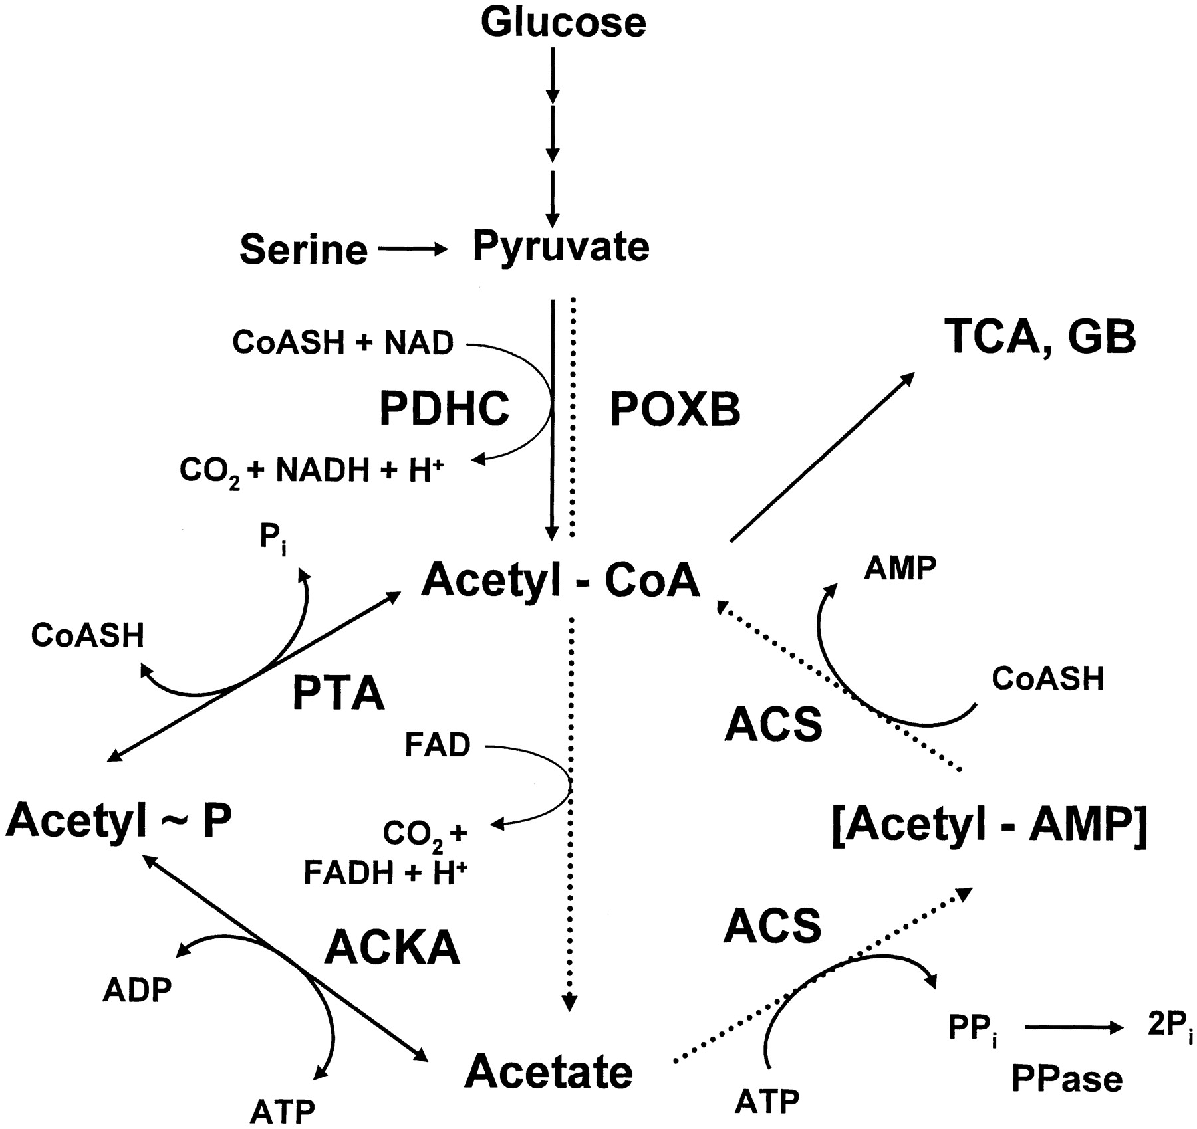
Acetate activation pathways.
Alan J. Wolfe Microbiol. Mol. Biol. Rev. 2005; doi:10.1128/MMBR.69.1.12-50.2005
Notes:
Acetate activation pathways. PDHC, pyruvate dehydrogenase complex; POXB, pyruvate oxidase; PTA, phosphotransacetylase; ACKA, acetate kinase; ACS, AMP-forming acetyl-CoA synthetase; PPase, pyrophosphatase; TCA, tricarboxylic acid cycle; GB, glyoxylate bypass. The dotted arrows denote the proposed PDHC bypass formed by POXB and AMP-ACS.

